Slide 1
It’s a Contradiction? No It’s Not! A Case Study Using Functional Relations
Alan Ritter, Doug Downey, Stephen Soderland, Oren Etzioni
Turing Center
University of Washington

Slide 2
Outline
Contradiction Detection
AuContraire:
Contradiction Detection with Functions
Experiments
Conclusions
Notes:
Focus on functional…
“Detecting contradiction”
Get rid of numbering
Skip points
Leave out subpoints
Add to outline later…

Slide 3
Detecting Contradictions
BornIn
Mozart was born in Salzburg
Mozart was born in Vienna
Visited
Mozart visited Salzburg
Mozart visited Vienna
Mozart was born in Austria
BornIn is Functional, but Visited is not.
Notes:
Knowing that “born in” is a function is not enough…

Slide 4
Background Knowledge
Find (T,H) which contradict with high probability
Background Knowledge is Key:
Example:
Mozart was born in Salzburg
Mozart was born in Austria
Not a Contradiction!
PartOf(Salzburg, Austria)

Slide 5
Motivating Applications
Political Analysis
Highlight controversial facts
Analyze Scientific Literature
Find inconsistencies
Fact Checker
Similar to Spell Checker, or Grammar Checker
Notes:
Question Answering/Textual inference?

Slide 6
Related Work
Condrovardi et. al. 2003
First proposed contradiction detection
Harabagiu et al. 2006
First empirical results
Manually negated entailments from RTE (Recognizing Textual Entailment)
de Marneffe et al. 2008
Annotated RTE data for contradictions
Wide variety of contradiction types
23% precision 19% recall
Notes:
Relatively unexplored area.
“Say Recognizing Textual Entailment”

Slide 7
Our Contributions
Finding contradictions “in the wild”
RTE contains hand-selected pairs
“Balanced data” – high proportion of contradictions
Focus on Functional Relations
Previous work mostly dealt with “negation” and “antonyms”
Background Knowledge is Key
E.g. Salzburg does not conflict with Austria
Notes:
We want to find pairs of sentences which contradict in a large corpus, instead of among hand-selected pairs of sentences.
Pervious work used artificially “balanced” data sets
We focus on finding contradictions using functional relations in contrast to previous work which has mostly exploited “negation” and “antonyms”
We emphasize the importance of background knowledge in the contradiction detection task.

Slide 8
Outline
Contradiction Detection
AuContraire:
Contradiction Detection with Functions
Detecting Contradictions
Identifying Functional Relations and Ambiguous Arguments
Experiments
Conclusions

Slide 9

AuContraire – A Contradiction Detection System Based on Functions
Begin with (Subject, Verb, Object) triples
TextRunner (Banko et. al. 2007)
Identify Functional Relations
Generate “apparent contradictions”
Sift out genuine contradictions
Notes:
We use a simpler representation than previous work to make contradiction detection “in the wild” feasible
Automatically identify functional relations
Group together extractions with the same argument and functional relation, but differing values
Use background knowledge to filter out false positives

Slide 10
How to Find Contradictions Using Functions?
Intuition: single correct value
Invented(Basketball, <PERSON>)
<PERSON> | Frequency of Extraction
James Naismith | 16
Aztecs | 1

Slide 11
Problem: Many Seeming Contradictions
Meronyms
Synonyms
Type mismatch
Ambiguous Arguments
We Need Background Knowledge!

Slide 12
Meronyms
Example:
BornIn(Mozart, Salzburg)
BornIn(Mozart, Austria)
AuContraire’s Sources of Meronyms
Tipster Gazetteer
WordNet
Notes:
Define meronym (“part of relation”)

Slide 13
Synonyms
Example:
DiedFrom(Mozart, kidney failure)
DiedFrom(Mozart, renal failure)
AuContraire’s Sources of Synonyms:
WordNet
RESOLVER (Yates and Etzioni 2007)
Token based string similarity (Cohen et al. 2003)

Slide 14
Type Mismatch
Example:
BornIn(Mozart, Salzburg)
BornIn(Mozart, 1756)
Use a Named Entity Tagger to assign high level types
Person
Location
Date
Other

Slide 15
Ambiguity
Example:
BornIn(John Smith, 1850)
BornIn(John Smith, 1737)
Later…
Ambiguity is not an issue in RTE data
Notes:
Ambiguity isn’t an issue in the RTE
Same name doesn’t refer to two different people
John Smith – very common name.
polysemy

Slide 16
Outline
Contradiction Detection
AuContraire:
Contradiction Detection with Functions
Detecting Contradictions
Identifying Functional Relations and Ambiguous Arguments
Experiments
Conclusions

Slide 17
Relation Functionality
Compute Probability of Functionality
URNS model (Downey et. al. 2005)
Average across all arguments
Invented(Basketball, Y)
LivedIn(Einstein, Y)
Y | Frequency of Extraction
James Naismith | 16
Aztecs | 1
Y | Frequency of Extraction
Germany | 6
Princeton | 6
Berlin | 5
America | 3
…
17
Notes:
Larger font for titles
Local functionality - undefined
Probability
We estimate the functionality of a relation by inspecting the distribution of values for a specific argument
If there is predominantly one value for an argument, then the relation appears functional. If there are many values for one argument, then it appears non-functional
We use URNS to compute these distributions into probabilities
For example because the

Slide 18

Argument Ambiguity
BornIn(<PERSON>, <LOCATION>)
<PERSON>=Einstein
<PERSON>=Smith
<LOCATION> | Frequency of Extraction
Germany | 80
Switzerland | 2
<PERSON> | Frequency of Extraction
Brooklyn | 5
Texas | 5
New York | 4
St. Louis | 3
Pittsburgh | 3
Toronto | 2
Boston | 2
… | (15 more)
Notes:
The same process can be applied to detect which arguments are ambiguous in our corpus
We know that “BornIn” is functional
“Mr. Smith” is refers to many unique entities
“Einstein” appears less ambiguous than “Mr. Smith”

Slide 19
Relation Functionality
Only works when unambiguous
Invented(Basketball, Y)
Invented(a process, Y)
Y | Frequency of Extraction
James Naismith | 16
Aztecs | 1
Y | Frequency of Extraction
Bouchage | 8
Charles Goodyear | 8
Henry Bessemer | 8
Daniel Berg | 8
…
19
Notes:
Returning to functionality
Although “Invented” is functional, it appears non-functional when applied to an ambiguous argument such as “the process” which refers to many unique inventions.
We need to know which arguments are unambiguous in order to measure functionality.

Slide 20
Detecting Functionality and Ambiguity
Functionality: Only use unambiguous args
Ambiguity: Only use functional relations
Expectation Maximization-like process
Alternately update two disjoint sets of parameters
Estimate
Functionality
Estimate
Ambiguity
Notes:
If we knew which arguments were ambiguous, we would not use them in computing functionality
If we knew which relations were functional we would only use those when computing ambiguity
Alternate between computing functionality and ambiguity, using our estimate from the previous step in each case
We found that this improves our performance.

Slide 21
Outline
Contradiction Detection
AuContraire:
Contradiction Detection with Functions
Experiments
Functionality/Ambiguity
Contradictions
Conclusions

Slide 22
Experimental Setup: Functionality and Ambiguity
1000 most frequent relations
Sufficient evidence to estimate functionality
Computed functionality and ambiguity
No EM
EM: Converged after 5 iterations
Hand labeled test set
Relations
A sample of arguments

Slide 23
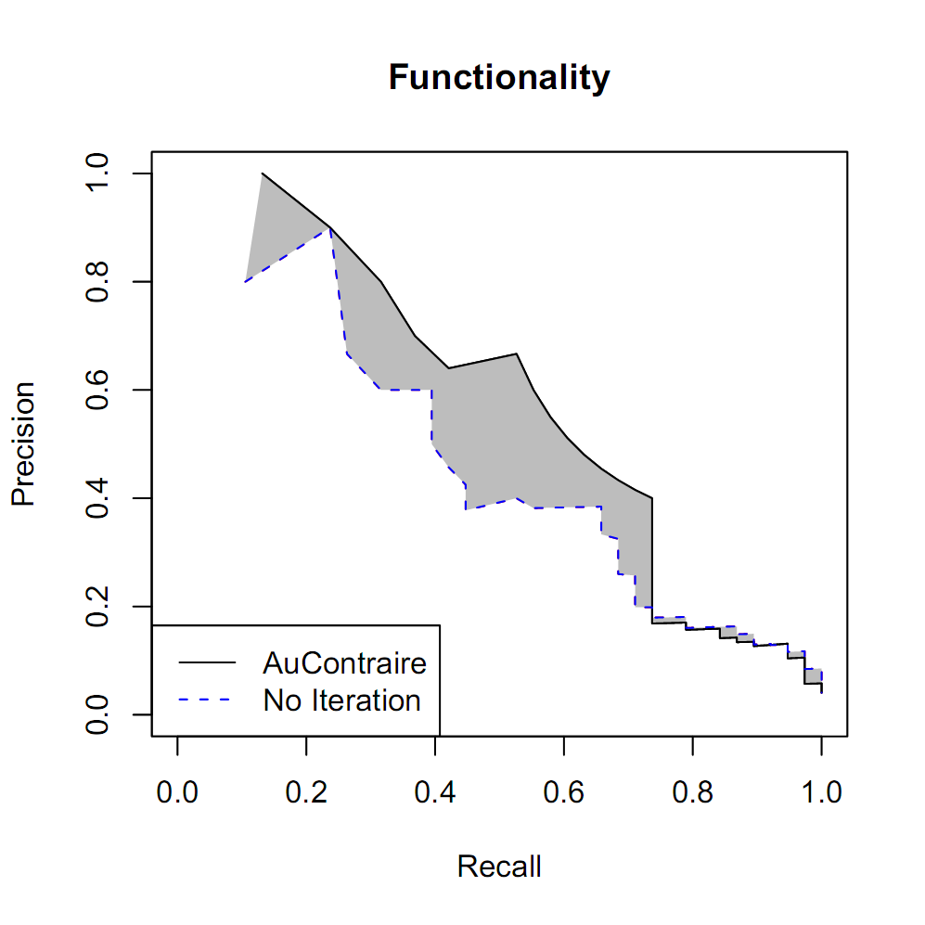
19% boost in AUC
Notes:
EM boosts our performance at detecting functions by 19%
Put these two graphs on the same slide.

Slide 24
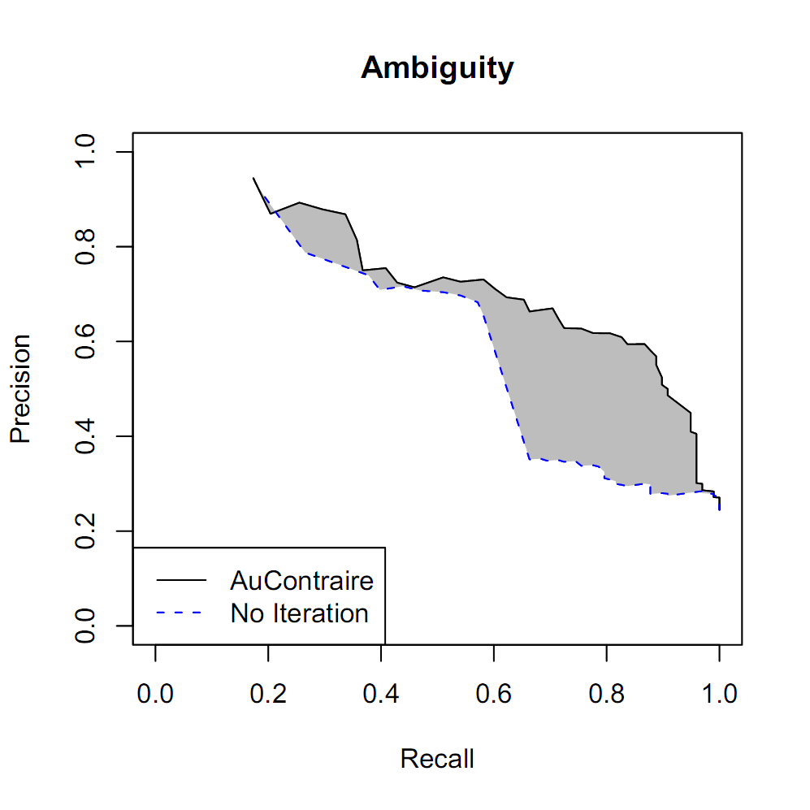
31% boost in AUC
Notes:
EM boosts our performance at ambiguity detection by 31%

Slide 25
Results: Functionality and Ambiguity
19% boost in AUC
31% boost in AUC
Notes:
EM boosts our performance at detecting functions by 19%
Put these two graphs on the same slide.

Slide 26
Experimental Setup: Contradiction Detection
Keep top 20 relations out of 1000
Hand-Tagged a sample of contradictions
10% rel-arg pairs
1.2% true contradictions (without filtering)
Use Logistic Regression to trade precision for recall
10 fold cross validation
Features:
Functionality/Ambiguity
String similarity between y values (Synonyms)
Etc…
Notes:
Too many numbers? – removed 10% rel-arg pairs
Phrase 1.2% better. Make outstanding…
True test is detecting contradictions

Slide 27
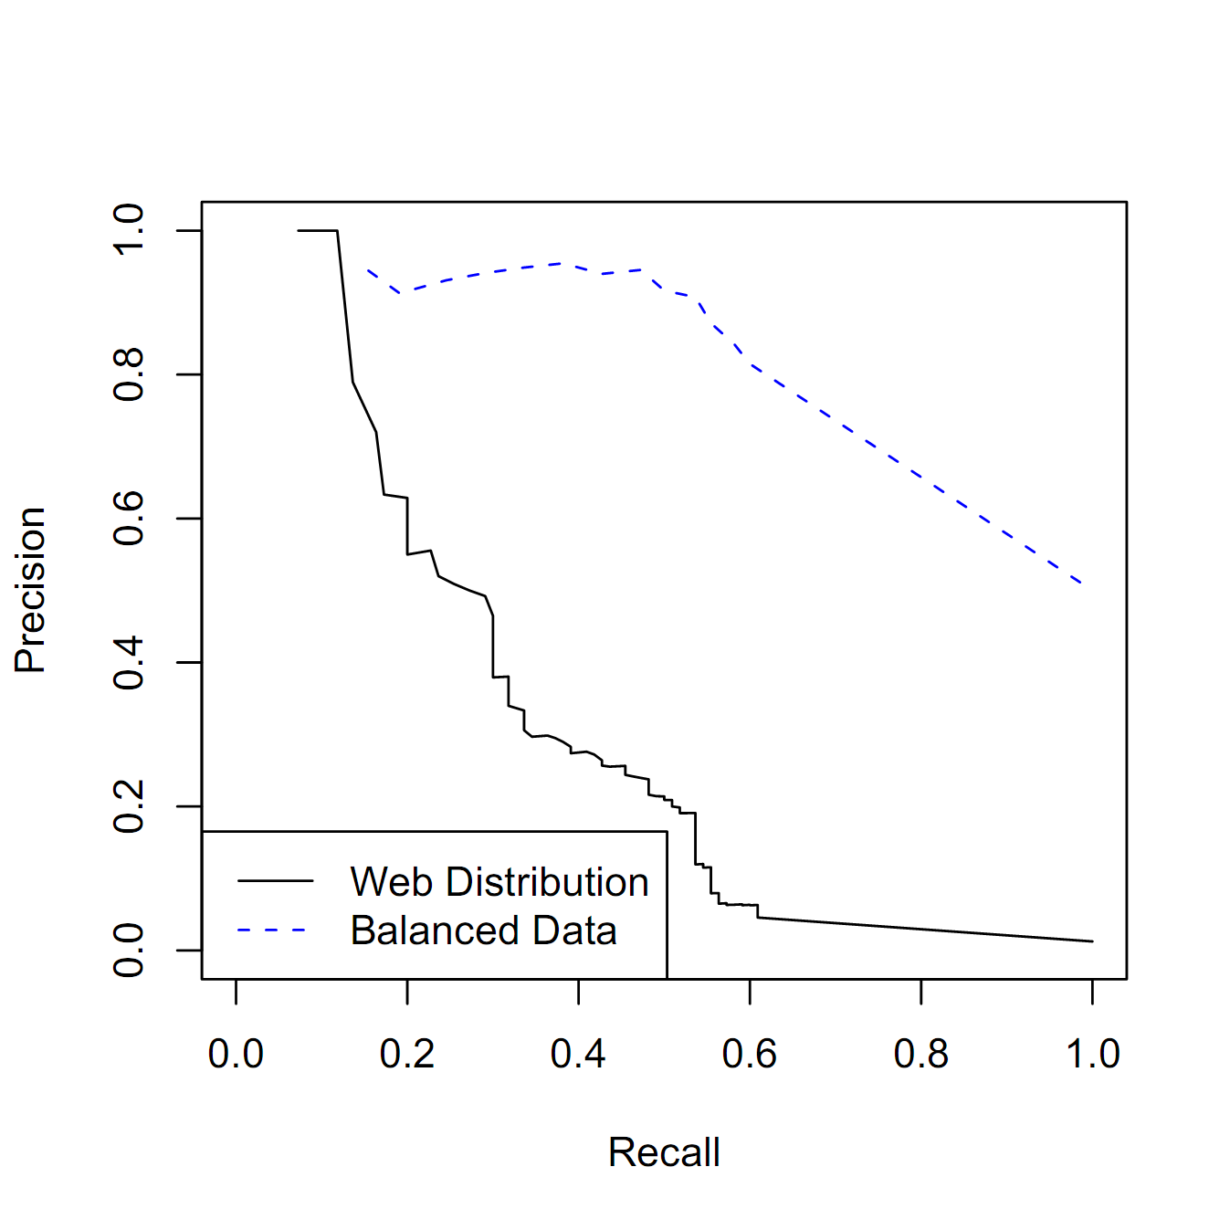
Contradiction Detection
Notes:
We are able to achieve high precision at low recall
Contradiction detection is much harder on “natural” data than artificially balanced data sets, such as the RTE.

Slide 28
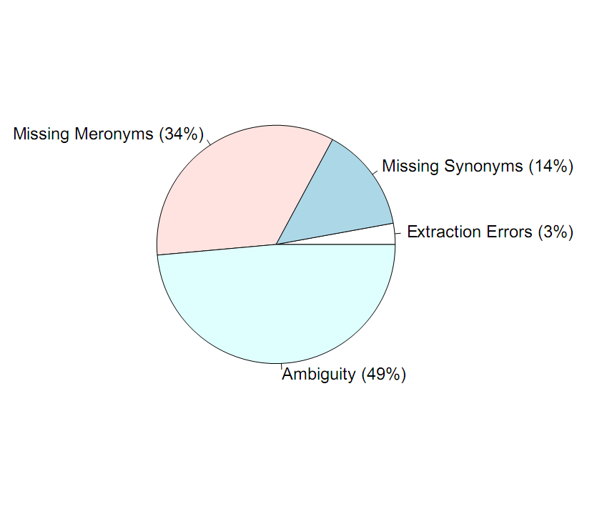
Error Analysis
Notes:
Gain intuition about how best to improve our system
Ambiguity is the biggst challenge, need some sort of reference resolution between

Slide 29
Future Work
Ambiguity
Cross-Document CoReference Resolution
Focus on a specific domain (e.g. political news)
Sparsity
Move beyond the 1000 most frequent relations
Which sentence is correct?
How trustworthy is the source of information?

Slide 30
Conclusions
AuContraire
Contradiction Detection with Functions
First work to do CD “in the wild”
Web corpus
EM-like algorithm for detecting:
Functionality
Ambiguity
Much external knowledge needed

Slide 31
Thank you!

Slide 32
